Slide 1
Health Insurance Coverage Change, Medicare Hospital Spending and their correlations with Potentially Preventable Deaths Among the Five Leading Causes of Death — United States, 2010 to 2016
Subtitle

Slide 2
1. Medicare Hospital Spending by Claim from Data.gov
The data displayed here show average spending levels during hospitals Medicare Spending per Beneficiary (MSPB) episodes.
This dataset provides the pre-risk-adjusted values to help the public understand the MSPB Measure and its composition.

Slide 3
2.Health Insurance Coverage rates before and after the Affordable Care Act from kaggle.com
This dataset provides health insurance coverage data for each state and the nation as a whole, including variables such as the uninsured rates before and after Obamacare, estimates of individuals covered by employer and marketplace healthcare plans, and enrollment in Medicare and Medicaid programs.

Slide 4
3. NCHS - Potentially Excess Deaths from the Five Leading Causes of Death from data.gov
* Potentially Excess Deaths from the Five Leading Causes of Death in Nonmetropolitan and Metropolitan Areas, United States, 2005-2015.
* Heart disease , Cancer , Unintentional injury , Chronic lower respiratory disease , Stroke are the five leading causes of death.
* Benchmarks are based on the three States with the lowest age and cause-specific mortality rates. We used “Benchmarks 2010 Fixed” as a fixed benchmark based on the best performing States in 2010.
* Potentially excess deaths for each State are calculated by subtracting deaths at the benchmark rates (expected deaths) from observed deaths.

Slide 5
Introduction:
# The Affordable Care Act (ACA) or nicknamed Obamacare, is signed into law by President Barak Obama on March 23, 2010. The ACA's major provisions came into force in 2014.
# We will look at the expansion of Healthcare coverage across the 50 states over the period of 2010 to 2016 and cross reference it with the Medicare Expenditures per Beneficiary over the same time and Span.
# The five leading causes of death in the United States are heart disease, cancer, chronic lower respiratory diseases, stroke, and unintentional injuries. Together they accounted for 63 percent of all U.S. deaths in 2010, with rates for each cause varying greatly from state to state. *[ ]
# We assume that the death rate in states declined as more people gained health insurance. We will analysis the relationship between death rate change in 51 states and all kinds of health insurance enrollment coverage change from 2010 to 2015.
# We will analysis the correlation between the Medicare Expenditures per Beneficiary and death rate change in each state.

Slide 6
Question 1:
Which states observed the greatest decline in their uninsured rate? Which states observed the least decline in their uninsured rate? Did those states expand Medicaid program coverage have more insurance coverage?
Question 2:
What is the correlation between the Marketplace Health Insurance Coverage and other medical insurances since 2015? Did those states expand Medicaid program coverage have more Health insurance coverage gains ?
Question 3:
What is the correlation between the Medicare Insurance Coverage and other medical insurances since 2015? Did those states expand Medicaid program coverage implement a health insurance marketplace?
Question 4:
If the change in percentage covered per state and nationally had a demonstrable effect on cost per beneficiary in that state and nationally.
Question 5:
Did those states which have the higher Medicare hospital spending also have the higher health insurance Enrollment in 2015 or 2016?

Slide 7
Question 6:
Is there any correlation between the death rate change(2010 -2015) and health insurance coverage change in each states?
Question 7:
Is there any correlation between individual disease caused death rates and uninsured rates in 50 states?
Question 8: Is there any correlation between Medicare hospital spending and death rates in 50 states?

Slide 8
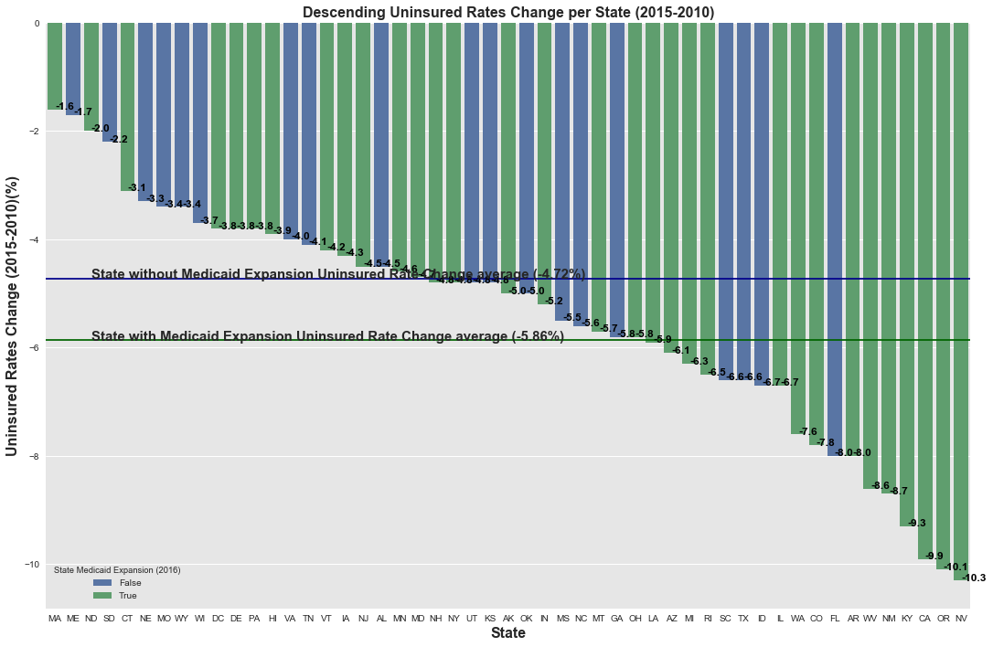
Since 2010 to 2015, Health insurance coverage gains were especially strong in Medicaid expansion states
• Non-expansion states had an average uninsured rate change with a drop of 4.72 percentage points.
• Expansion states had an average uninsured rate change with a drop of 5.86 percentage points.

Slide 9
Nevada
Oregon
California
Kentucky
New Mexico
West Virginia
Arkansas
Florida
Colorado
Washington
Left are the first ten states which has the greatest decline of uninsured states from 2010 to 2015.
Florida is the only state which has no Medicaid program coverage expansion.
Massachusetts
Maine
North Dakota
South Dakota
Connecticut
Nebraska
Missouri
Wyoming
Wisconsin
District of Columbia
Left are the last ten states which has the least decline of uninsured states from 2010 to 2015.
There are six out of ten states which have no Medicaid program coverage expansion.

Slide 10
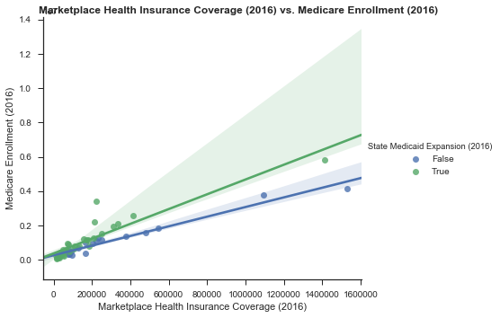
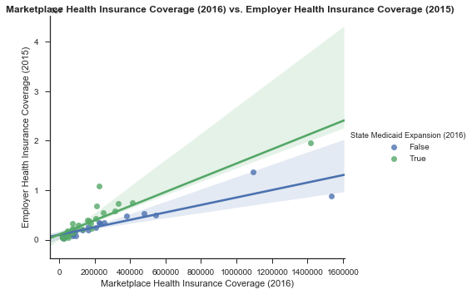
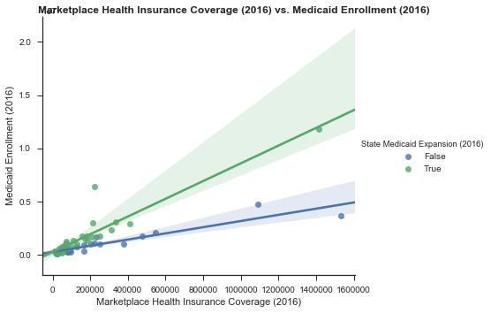
Marketplace Health Insurance Coverage( 2016) has the positive correlation with Medicare and Medicaid Enrollment (2016 )and Employer Health Insurance Coverage (2015) in 50 states.
Medicare, Medicaid and Employer Health insurance coverage gains were especially strong in Medicaid expansion states .

Slide 11
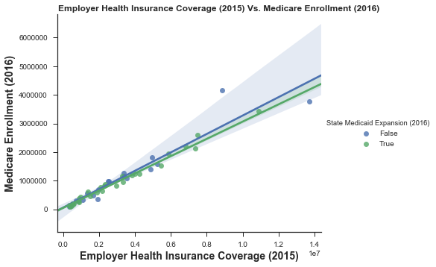
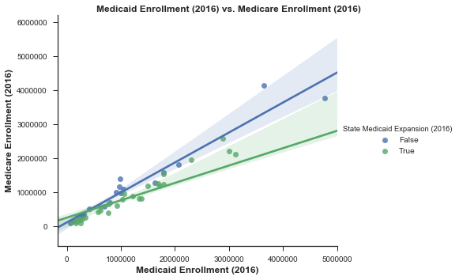

Medicare Health Insurance Coverage( 2016) has the positive correlation with Employer Health Insurance Coverage (2015) and Medicaid Enrollment (2016 )and Marketplace Health Insurance Coverage( 2016) in 50 states.
Medicare coverage gains were especially less in Medicaid expansion states .

Slide 12
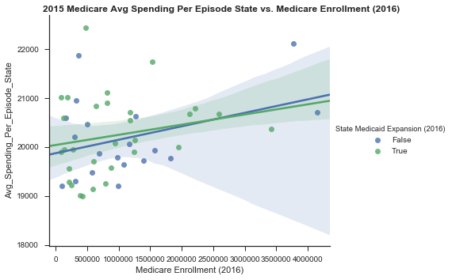
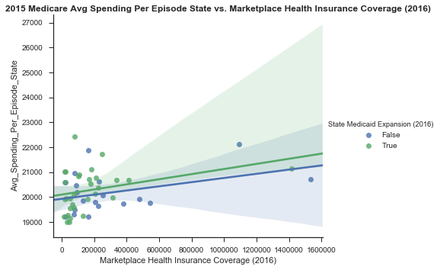
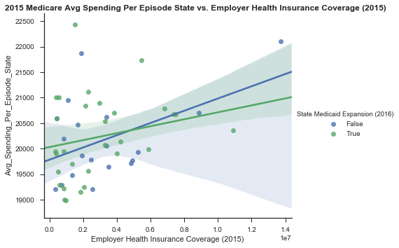
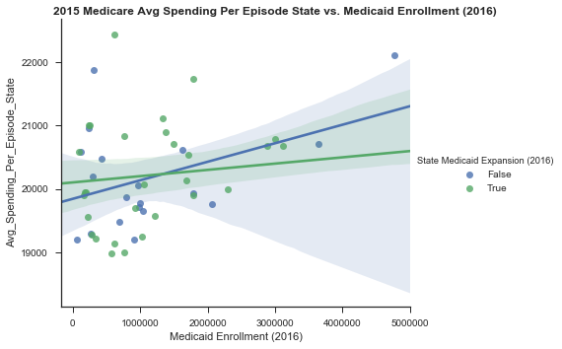

Slide 13
The states' Medicare hospital spending in 2015 increased following the Marketplace Health Insurance, Medicare and Medicaid Enrollment , Employer Health Insurance Enrollment increases in 50 states.
The states' Medicare hospital spending is slightly higher in those states with expanded coverage comparing to the states without expanded coverage.
But for those states with higher Medicaid and Employer Health Insurance Enrollment, the Medicare hospital spending were higher in the states without expanded coverage comparing to the states with expanded coverage. “Studies suggested that rejecting the expansion would cost more than expanding Medicaid due to increased spending on uncompensated emergency care that otherwise would have been partially paid for by Medicaid coverage”[ ].

Slide 14
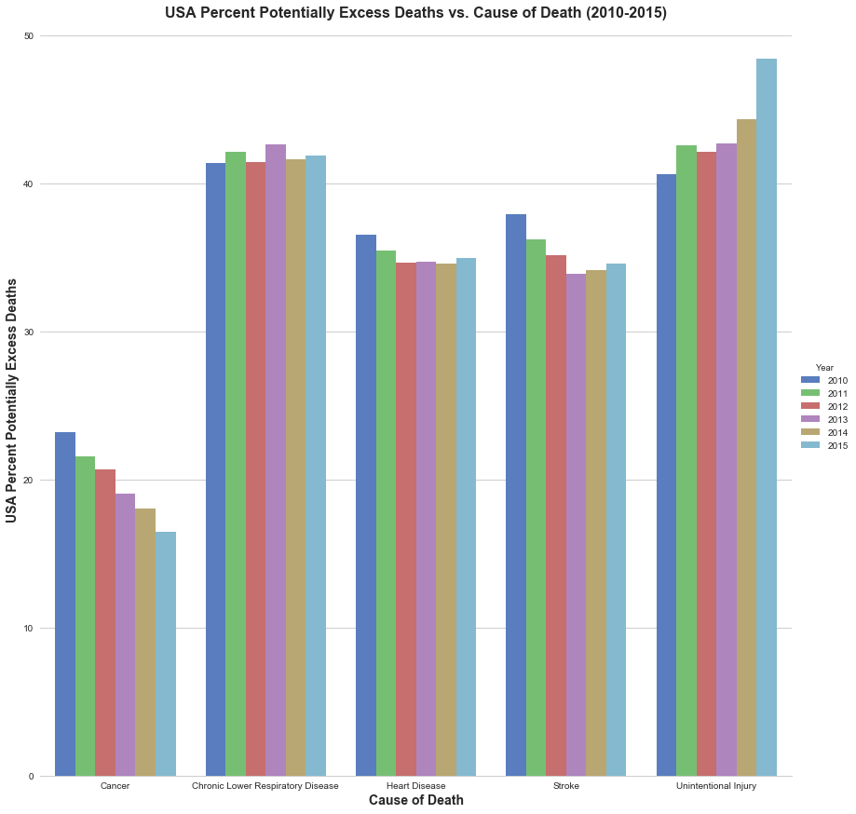
Compared with 2010, the estimated number of Percent Potentially Excess Deaths changed in 2015. Cancer deaths decreased 29% (from 23.2 to 16.5), stroke deaths decreased 9% (from 37.9 to 34.6 ), heart disease deaths decreased 4% (from 36.5 to 34.9), chronic lower respiratory disease (CLRD) (e.g., asthma, bronchitis, and emphysema) deaths increased 1% (from 41.4 to 41.9), and deaths from unintentional injuries increased 16% (from 48.4 to 40.6).

Slide 15
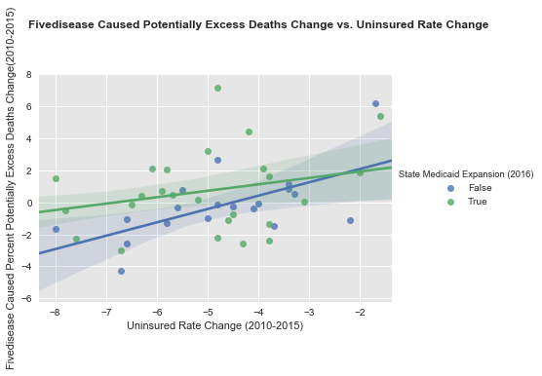
Mortality rates vary widely among states. Uninsured rates also vary widely between 2011 and 2015 in the 50 states.
We find there is a positive trend between Uninsured rates change (2010-2015) and death rate change (2010-2015) in each states in USA. For those states with higher health insurance enrollment increase, their death rates have decreased.

Slide 16
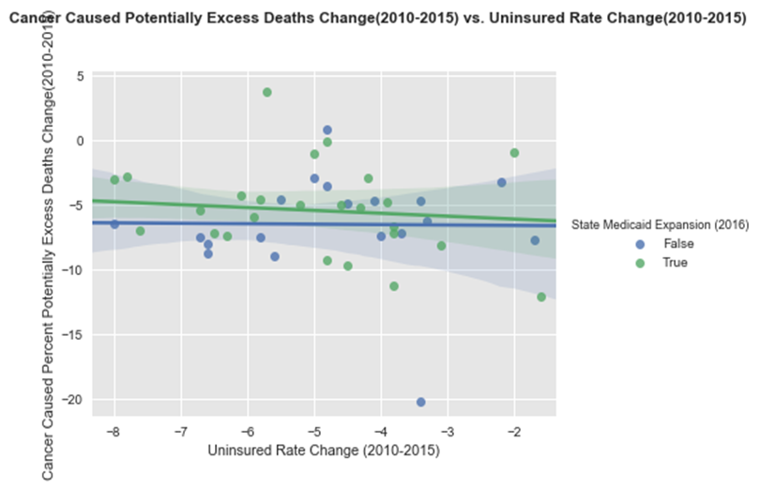
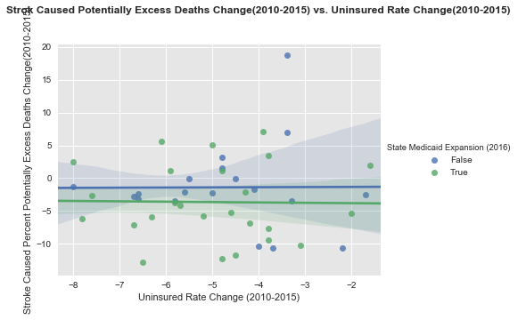
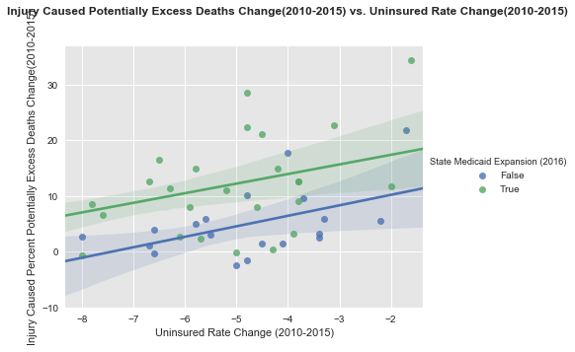
There are no correlation between the Cancer, stroke caused death rate change and uninsured rates change. Stroke caused death rates was lower in those states with Medicaid Expansion.
There are positive correlation between injury caused death rates change and uninsured rates change. For those states with higher health insurance enrollment increase, their death rates have decreased.
Injury caused death rates was higher in those states with Medicaid Expansion.

Slide 17
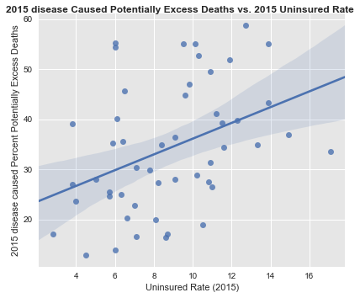
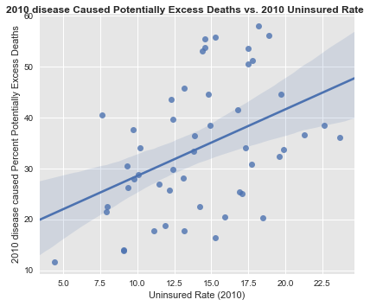
In 2010 and 2015, There are positive correlation between five disease caused death rates and uninsured rates in 50 states.

Slide 18
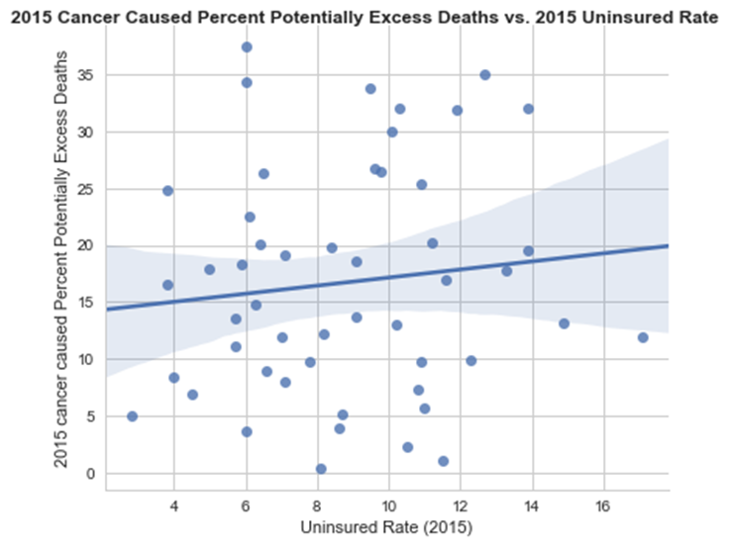
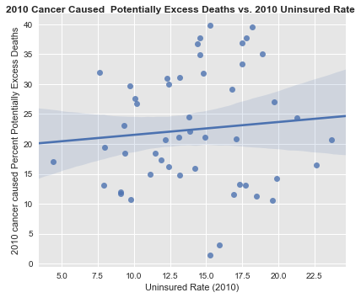
In 2010 and 2015, There are slightly positive correlation between cancer caused death rates and uninsured rates in 50 states.

Slide 19
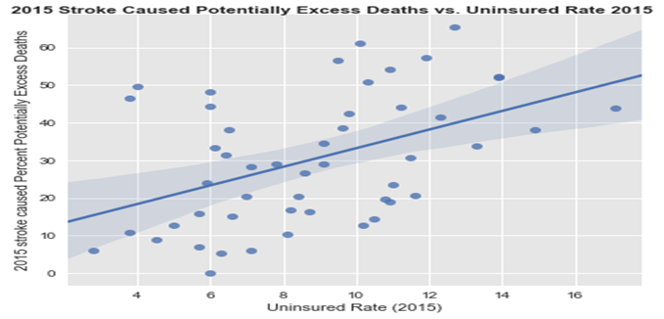
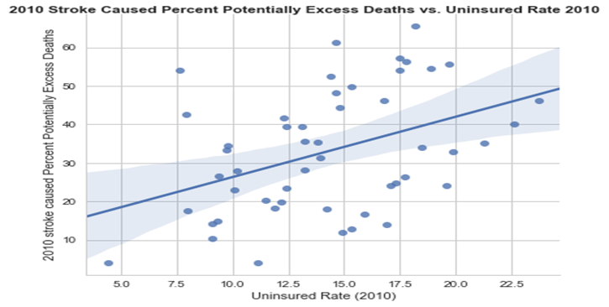
In 2010 and 2015, There are positive correlation between stroke caused death rates and uninsured rates in 50 states.

Slide 20
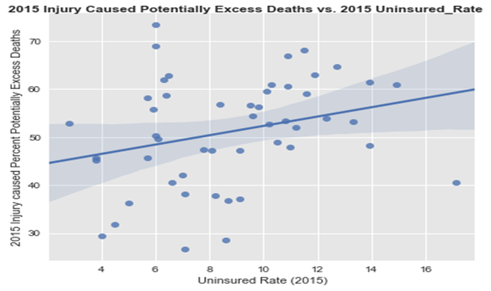
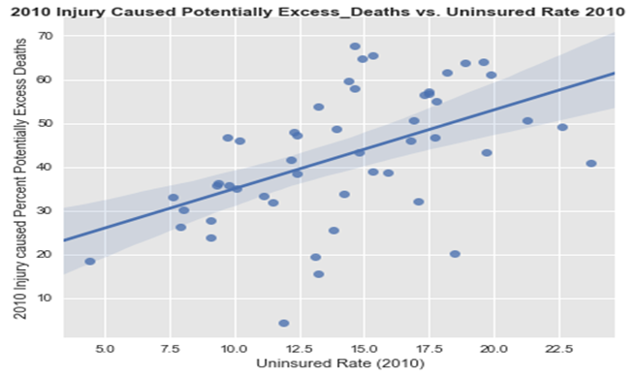
In 2010 and 2015, There are positive correlation between injury caused death rates and uninsured rates in 50 states.

Slide 21
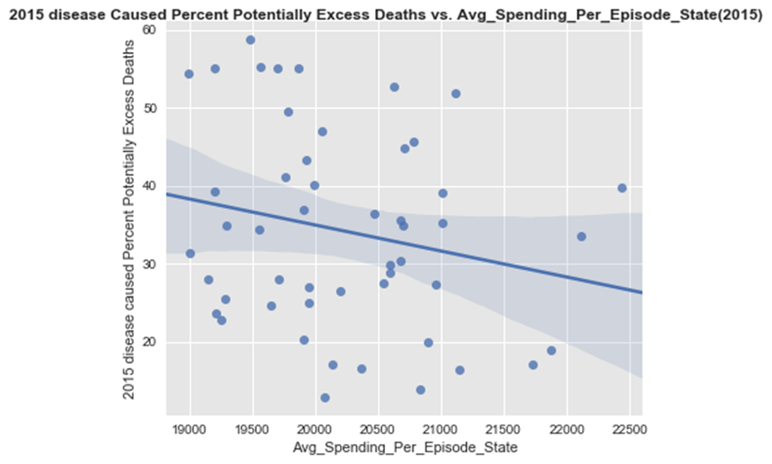
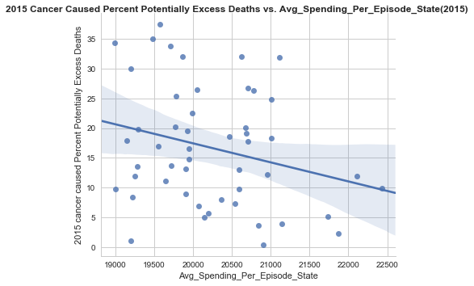
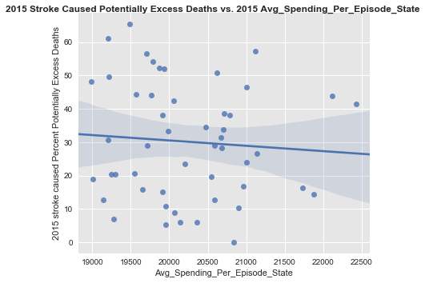
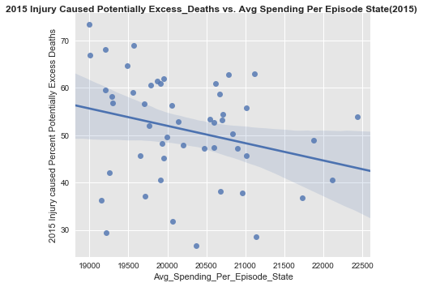
The death rate dropped in every states in the U.S. between 2010 and 2015. A decline of death rate was associated with a significant increase of hospital Medicare spending in all-cause mortality in each state.

Slide 22
Conclusion:
Since 2010 to 2016 , more uninsured people have gained health insurance coverage. Over that period, the uninsured rate dropped from 15.5 percent to 9.4 percent , a 40% reduction in the uninsured rate.
Those states that expanded Medicaid had an average uninsured rate change with a drop of 5.86 percentage points. while those that did not expand Medicaid had an average uninsured rate change with a drop of 4.72 percentage points.
Potentially preventable deaths declined during 2010–2015 for three of the five leading causes of death: diseases of the heart, cancer, and stroke. No change was observed for potentially preventable deaths from CLRD. Potentially preventable deaths from unin­tentional injuries increased each year from 2010 to 2015.
The mortality rate in 50 states declined substantially in the five years after the states increased their health care (including the Affordable Care marketplace health insurance) coverage.

Slide 23
Our project will help with:
Insurance coverage helps save lives, by encouraging early detection and prevention of dangerous medical conditions.* [ ] The analysis of state differences in death rates for the five leading causes of death and their correlations with hospital medical spending and health insurance coverage change could assist state and federal health officials in establishing prevention goals, pri­orities, and strategies.

Slide 24
Limitations:
What we could to do :
1. What contributed the increased coverage of health insurance? An expansion of Medicaid eligibility? or Affordable Care marketplace health insurance?
2. Compare the all kinds of health care hospital cost (not only Medicare hospital spending) to the health insurance coverage in each state.
3. Analysis both the expected and observed number of deaths for each cause and year.
4 . Defining potentially preventable deaths across the five leading causes does not take into consideration the fact that these are complex and diverse causes of death. In addition, the majority of risk factors do not occur randomly in populations; they are closely related to the social, demographic, environmental, economic, and geographic attributes of the neighborhoods in which per­sons live and work.

Slide 25
Reference:
https://en.wikipedia.org/wiki/Patient_Protection_and_Affordable_Care_Act
https://www.cdc.gov/media/releases/2014/p0501-preventable-deaths.html
https://www.cdc.gov/mmwr/volumes/65/wr/mm6545a1.htm--Potentially Preventable Deaths Among the Five Leading Causes of Death — United States, 2010 and 2014

Slide 26

Thank you!
Leo, Rowan and Angelo

Slide 27
Potentially Preventable Deaths from the Five Leading Causes of Death Heart disease risks include tobacco use, high blood pressure, high cholesterol, type 2 diabetes, poor diet, overweight, and lack of physical activity.
Cancer risks include tobacco use, poor diet, lack of physical activity, overweight, sun exposure, certain hormones, alcohol, some viruses and bacteria, ionizing radiation, and certain chemicals and other substances.
Chronic respiratory disease risks include tobacco smoke, second-hand smoke exposure, other indoor air pollutants, outdoor air pollutants, allergens, and exposure to occupational agents.
Stroke risks include high blood pressure, high cholesterol, heart disease, diabetes, overweight, previous stroke, tobacco use, alcohol use, and lack of physical activity.
Unintentional injury risks include lack of seatbelt use, lack of motorcycle helmet use, unsafe consumer products, drug and alcohol use (including prescription drug misuse), exposure to occupational hazards, and unsafe home and community environments.

Slide 28
* The decrease in cancer deaths can be attributed, in part, to progress in prevention, early detection, and treat­ment . * Improvement of quality of care and reduction in risk factors, including increased number of persons with hyperten­sion under control, have contributed to the decline in death rates for heart disease and stroke.*

